Slide 1
Flood monitoring and early warning

Slide 2
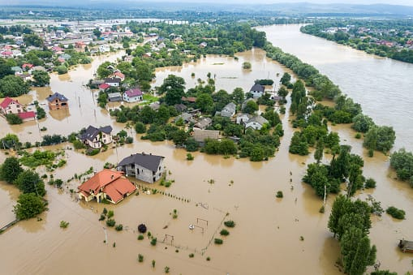
INTRODUCTION
Early warning systems can be set up to avoid or reduce the impact of hazards as flood, flash-floods, landslides, storms, forest fires etc. The significance of an effective early warning system lies in the recognition of its benefits by the members of the general public.The flood monitoring system and the alert system uses technology like wireless sensor network, embedded system with GSM technology, a camera sensor with image processing technology and the satellite-based monitoring software like GIS etc.

Slide 3
ABSTRACT
The purpose of this study is to develop a real-time flood monitoring and early warning system in the northern portion of the province of Isabela, particularly the municipalities near Cagayan River. Ultrasonic sensing techniques have become mature and are widely used in the various fields of engineering and basic science. One of advantage of ultrasonic sensing is its outstanding capability to probe inside objective non-destructively because ultrasound can propagate through any kinds of media including solids, liquids and gases. This study focuses only on the water level detection and early warning system (via website and/or SMS) that alerts concern agencies and individuals for a potential flood event. Furthermore, inquiry system is also included in this study to become more interactive wherein individuals in the community could inquire the actual water level and status of the desired area or location affected by flood thru SMS keyword. The study aims in helping citizens to be prepared and knowledgeable whenever there science.

Slide 4
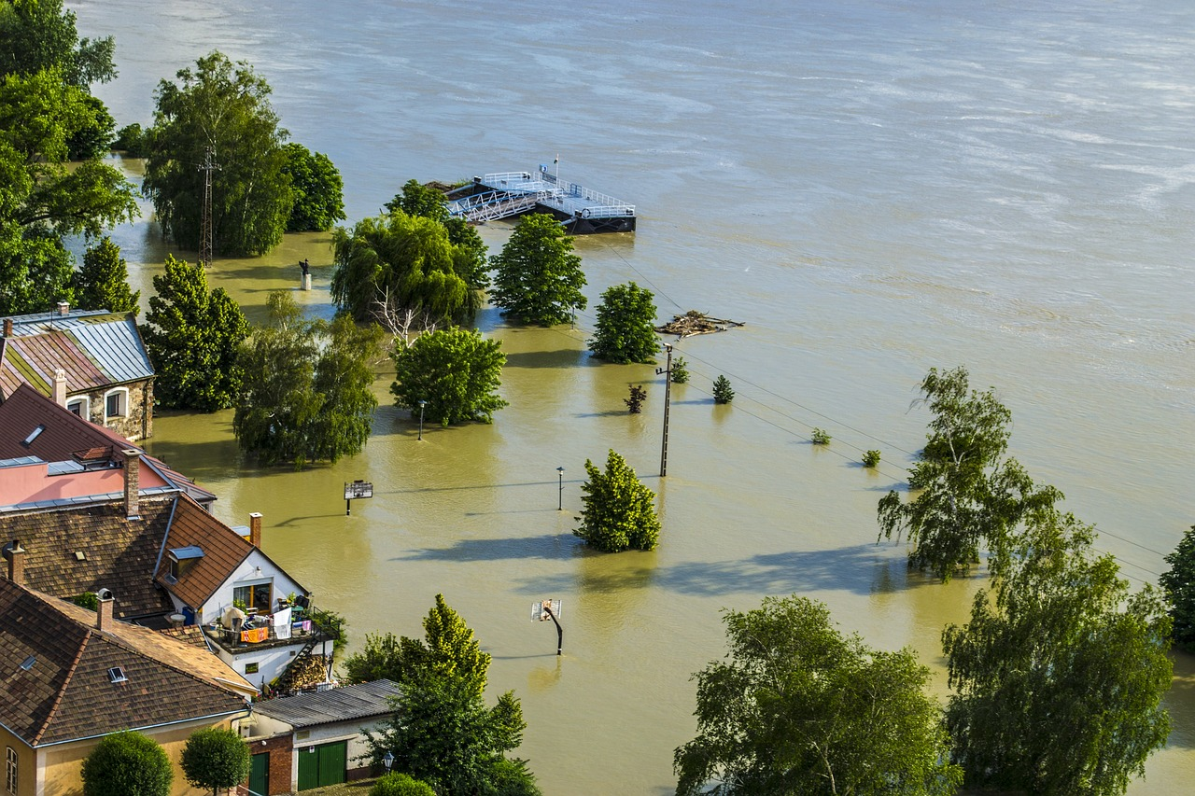
FLOOD
Floods are a type of natural disaster that can cause heavy destruction to life and property. It is a condition when rainwater accumulates at a place, flooding populated areas. They can also lead to the loss of numerous lives. At times, it can be highly dangerous and can wipe off an entire village or city.

Slide 5
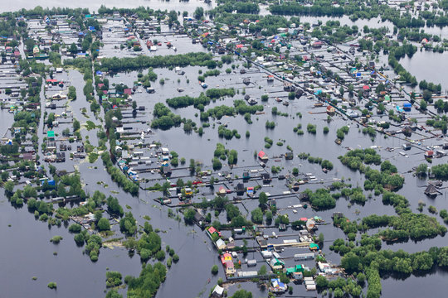
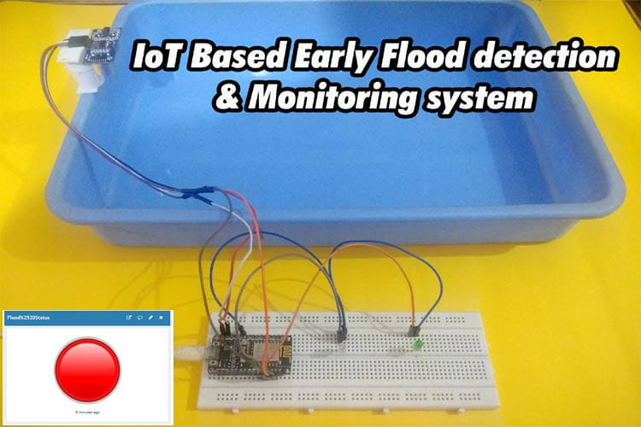
PROBLEM STATEMENT
The increasing frequency and severity of floods pose a significant threat to communities, infrastructure, and the environment. To address this critical issue, a comprehensive flood monitoring and early warning system is needed. The problem statement includes the following key aspects

Slide 6
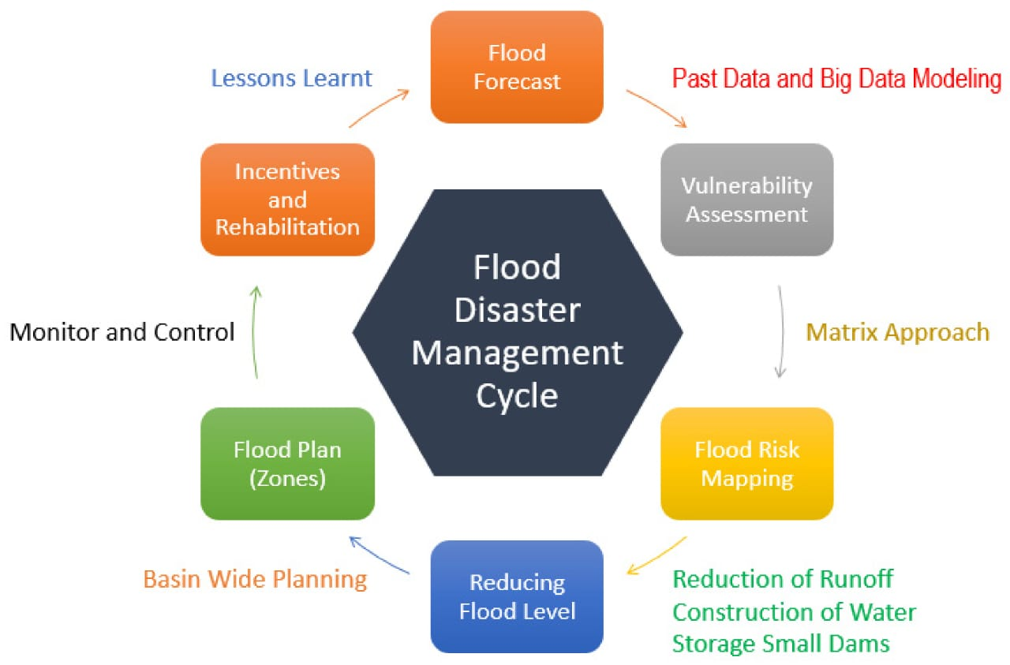
METHODOLOGY

Slide 7
PROBLEM SOLUTION
Sensor Network Deployment: Install a network of flood sensors in flood-prone areas. These sensors can detect water levels , rainfall, and weather conditions
Data Collection and Transmission: Sensors should continuously collect data and transmit it to a central server or cloud platform. This data should include real-time information about water levels, rainfall, and weather forecasts

Slide 8
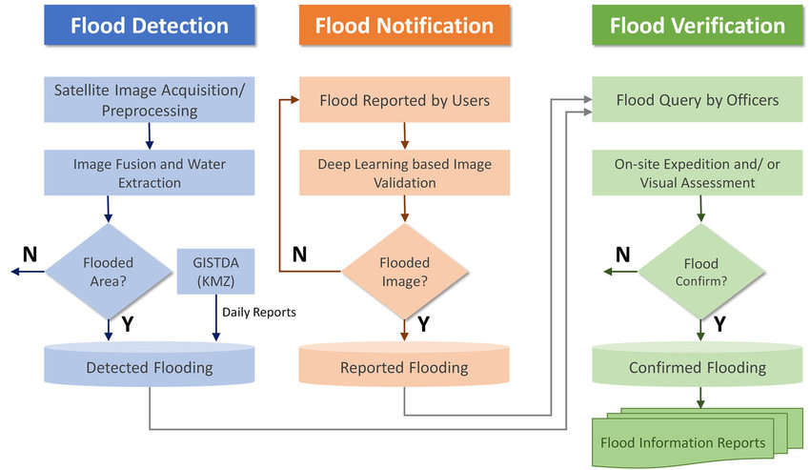
DESIGN

Slide 9
COMPONENTS
ARDUINO UNO
ULTRASONIC SENSOR
GSM
LCD DISPLAY
WATER LEVEL SENSOR

Slide 10
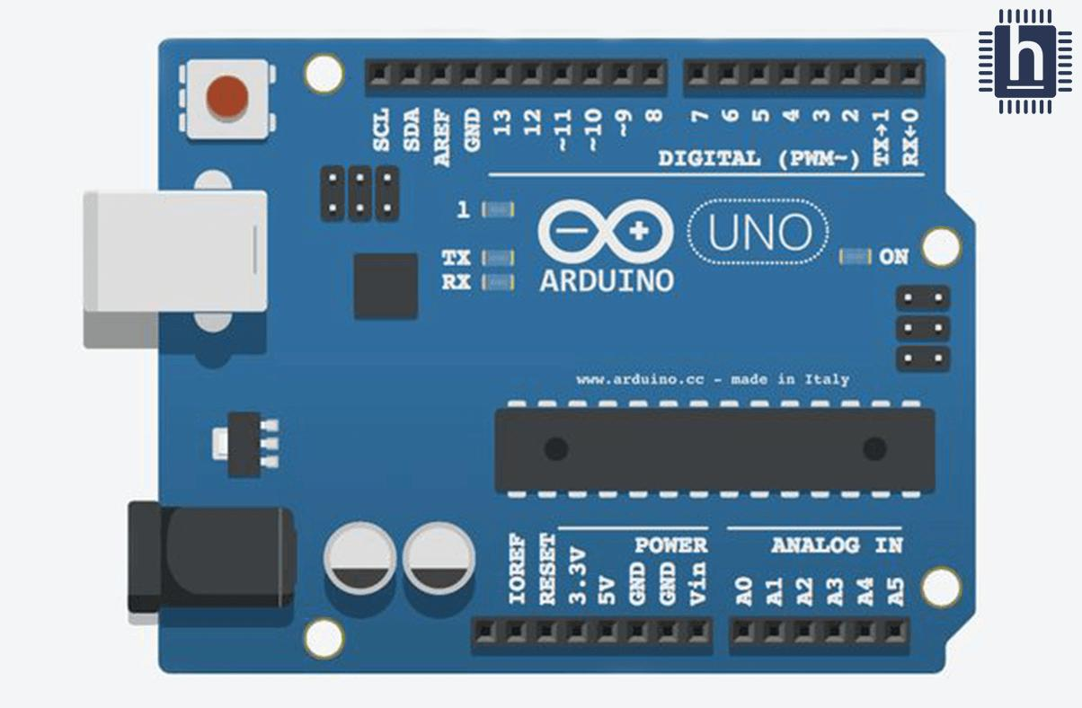
ARDUINO UNO
Arduino UNO is a low-cost, flexible, and easy-to-use programmable open-source microcontroller board that can be integrated into a variety of electronic projects. This board can be interfaced with other Arduino boards, Arduino shields, Raspberry Pi boards and can control relays, LEDs, servos, and motors as an output

Slide 11
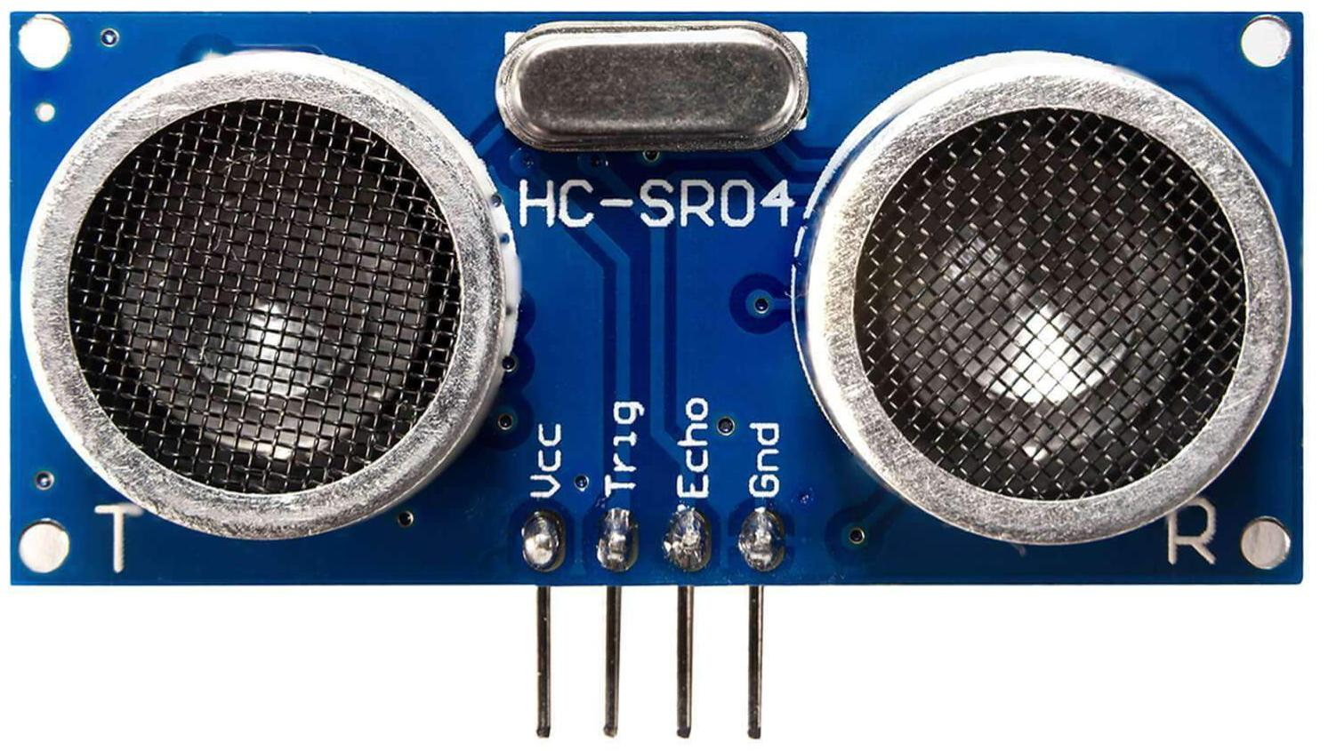
ULTRASONIC SENSOR
Ultrasonic sensor are used As they utilise high frequency sound waves To calculate the distance to a remote object without physically touching it, they can be used to create systems that reliably determine wave height and water levels at much lower installation and maintenance costs.

Slide 12
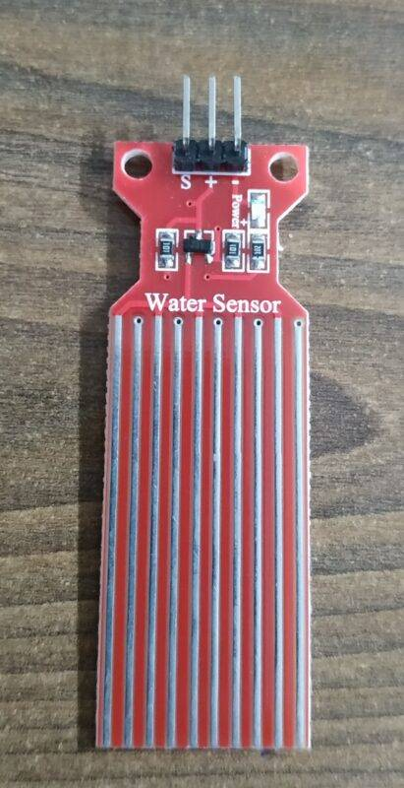
WATER LEVEL SENSOR
The sensor has ten exposed copper traces, five of which are power traces and the remaining five are sense traces. These traces are interlaced so that there is one sense trace between every two power traces. Normally, power and sense traces are not connected, but when immersed in water, they are bridged.

Slide 13
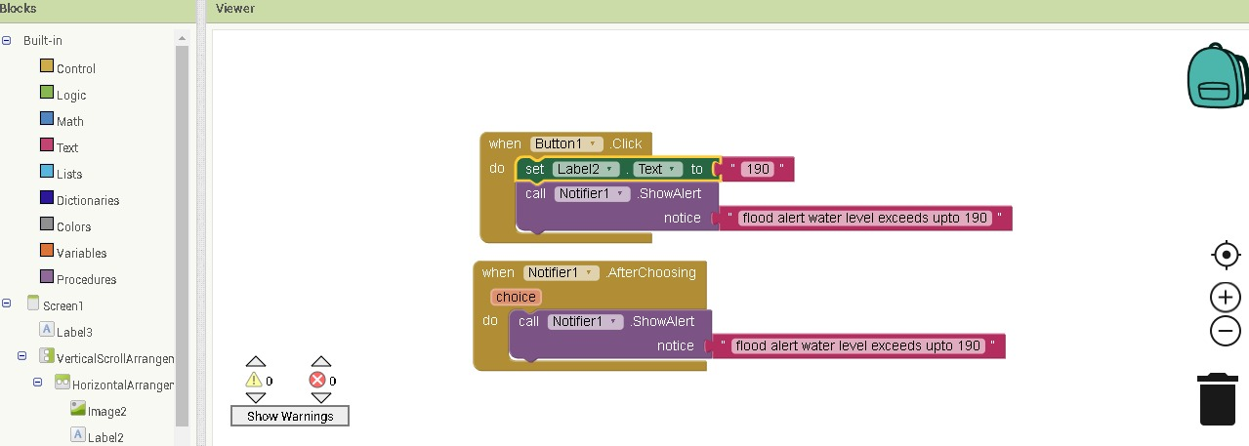
CODING

Slide 14
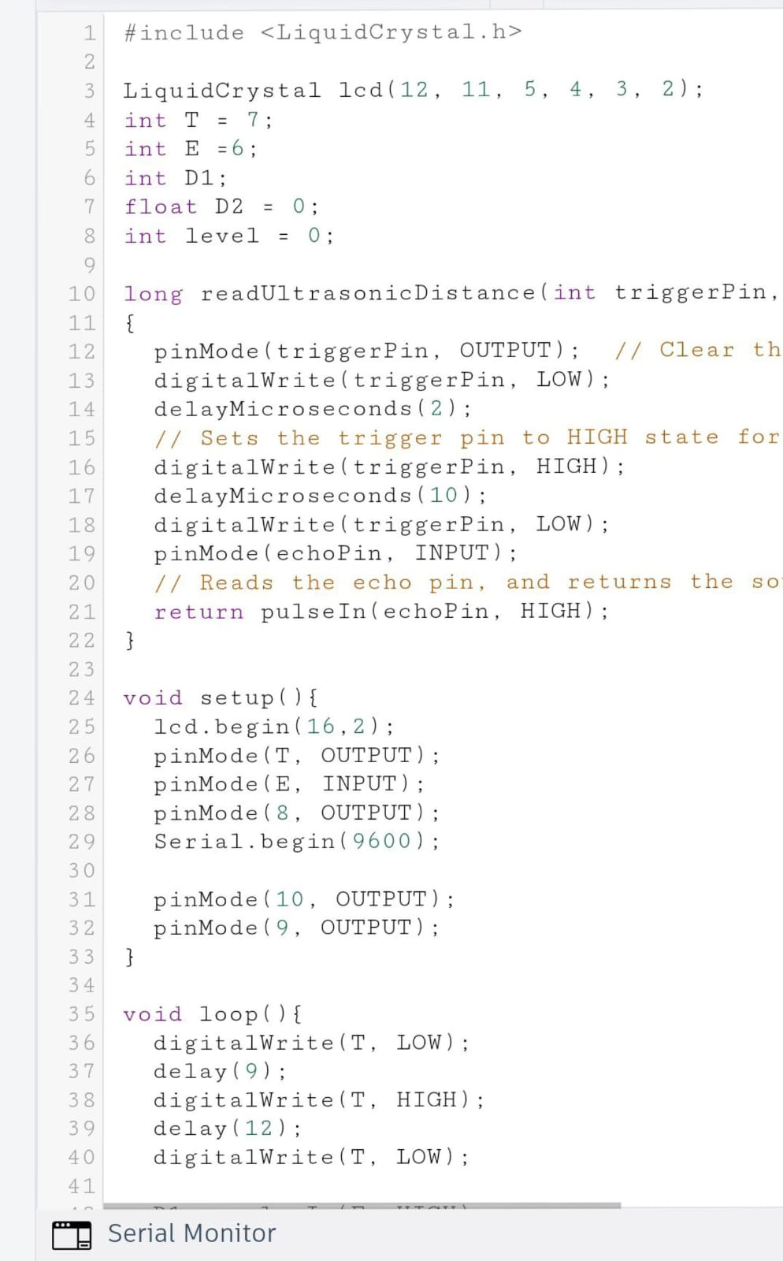
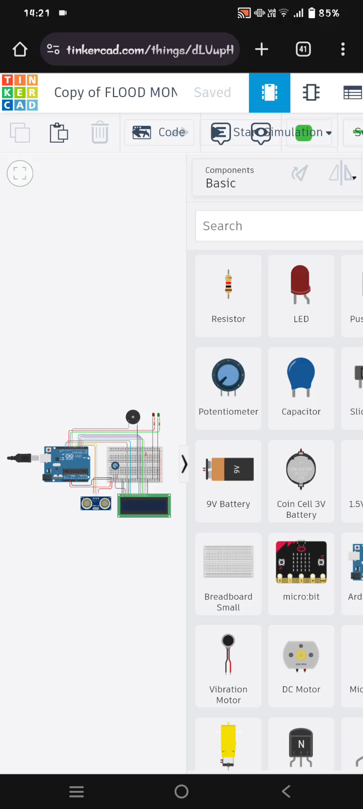
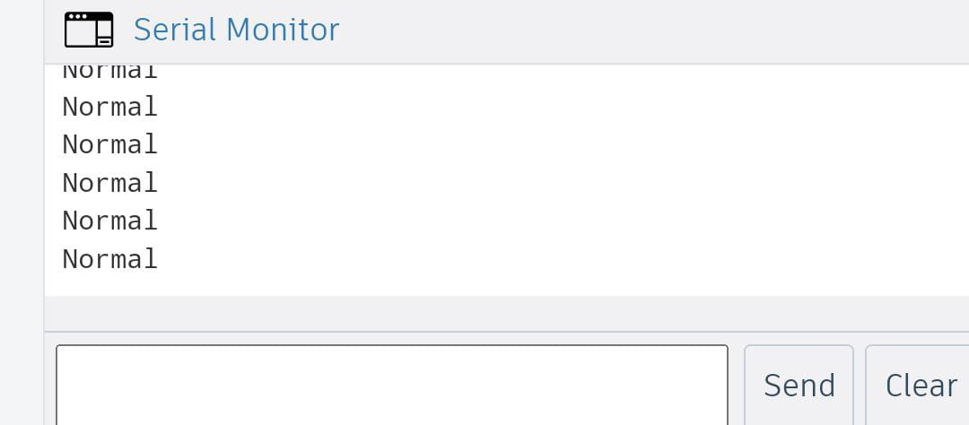
SIMULATION

Slide 15
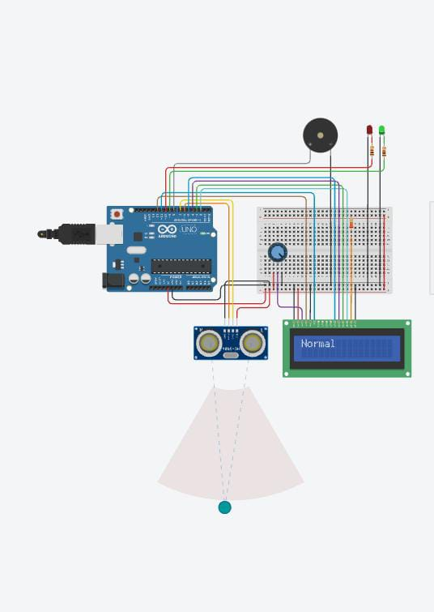

Slide 16
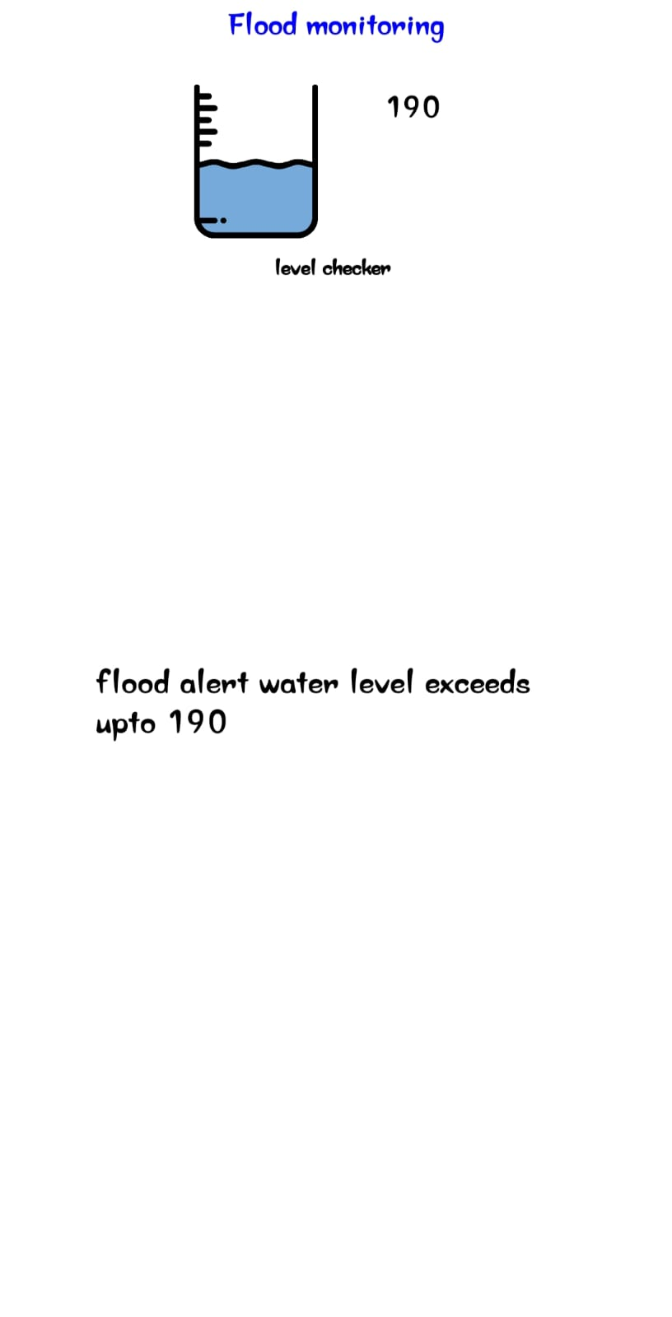
OUTPUT

Slide 17
CONCLUSION
In conclusion, flood monitoring and early warning systems play a pivotal role in mitigating the devastating impact of floods on both human lives and infrastructure. These systems employ advanced technology and data analysis to provide timely alerts, giving communities crucial time to prepare and evacuate if necessary. As climate change continues to increase the frequency and severity of floods, the importance of investing in and improving these monitoring and warning systems cannot be overstated. By embracing innovation and collaboration, we can work towards a future where flood-related disasters are minimized, and lives are saved.Flood monitoring is a crucial component of disaster management and environmental protection. It involves the continuous surveillance, assessment, and prediction of water levels and weather conditions to anticipate and respond to potential flood events. This proactive approach helps in early warning systems, safeguarding communities, and minimizing the devastating impact of floods on lives and property. Flood monitoring utilizes various technologies, such as weather radar, river gauges, satellite imagery, and computer modeling, to gather data and provide real-time information to decision-makers and the public, enabling timely response and mitigation efforts.

Slide 18
THANK YOU

